Slide 1
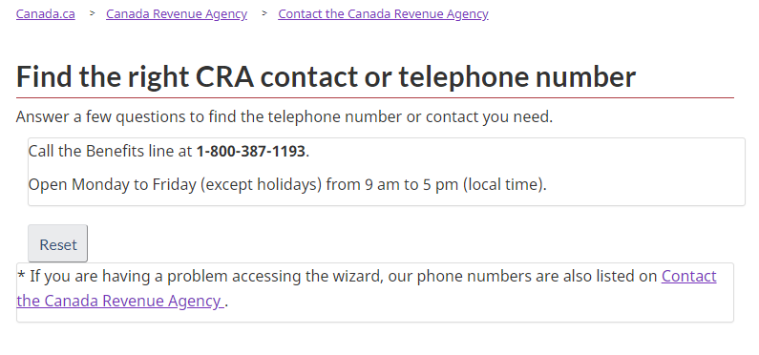
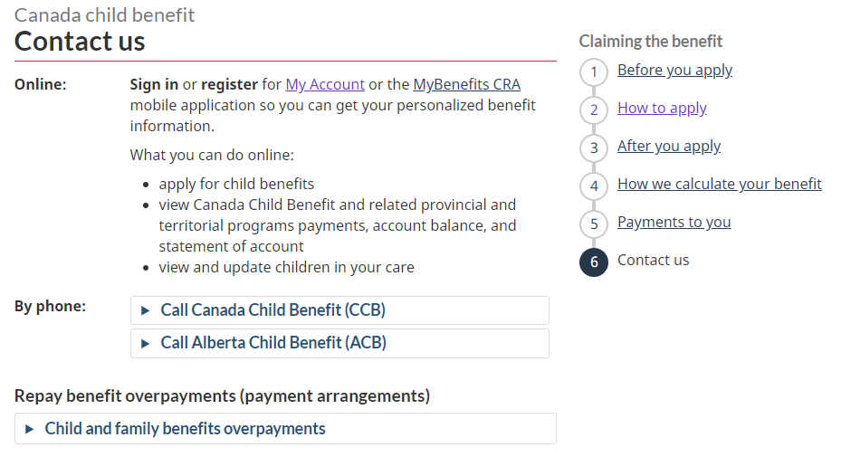
Improving the wizard
Find a phone number was implemented in Google DialogFlow
Needs to move to Wxt Field Flow or SurveyGizmo
That would enable linking directly to top contact pages instead of providing short answers
For example, if select Canada Child Benefit, it should display the CCB contact page with the Contact design pattern and context

Slide 2
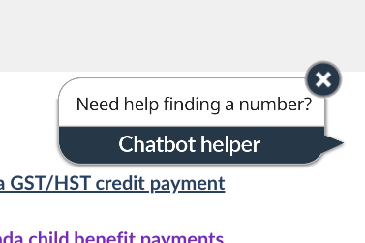
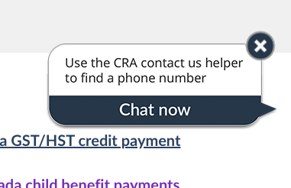
Chatbot was always available but no one opened
it to complete tasks - so it’s not essential for success
Seen by P1 to P4 - no one used it but a participant mentioned they thought it would be a real person so design was changed
Seen by P4 to P19 - still no one used it P14 and P12 closed it to get it out of the way
See separate report on learning, participant experience on the chatbot, and with a Voice agent version.

Slide 3
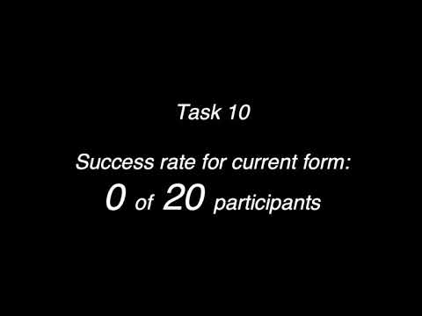
Finding addresses for forms
- a top task on Contact Us
and 90,000 calls per year
Video overview for Form tasks - Before and After https://youtu.be/YfeeA3K9Ldo

Slide 4
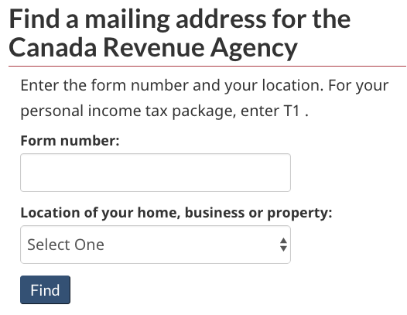
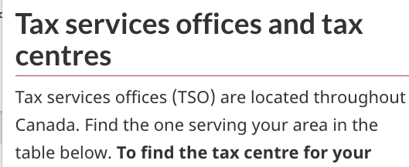
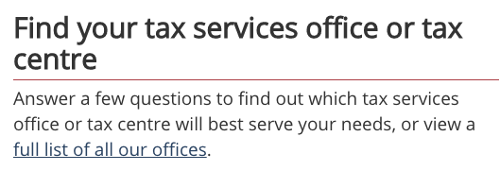
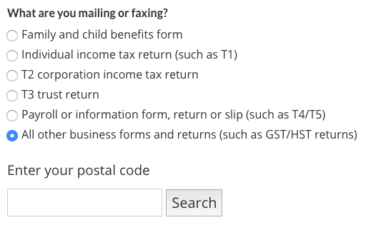
A progression of address experiments & learning
1
18% success
2
61% success
3
94% success
2018: Check if website helping people mail business documents like RC1 form - few successes
Test : Tried idea of a (fake) postal-code wizard to cover a few top forms - still too complex, only a few forms, postal code data not avail
2019: Simplify to provinces rather than postal codes, create a design that works for all forms and add simplified addresses to forms

Slide 5
No consistency in current PDF forms for addresses
Tasks:
RC1 form has sentence at top to send to PEI or Sudbury tax centre, with link to Tax Centre page
T2062 has paragraph about Centres of Expertise with link to Property page with addresses by region
E410 waiver - no address on the form at all
Other examples: CPT162 (address at bottom)
XE8 (address top right)
T4RIFSUM (address middle of 2nd page)
T3RET (top, says use guide - unclear about mailing)
TX19 (6 addresses bottom of first page)
TL11D (at top - see “information sheet RC190” - link provided “cra-forms” - but it’s a publication)
T5013-FIN (at top, says use guide, or online)

Slide 6
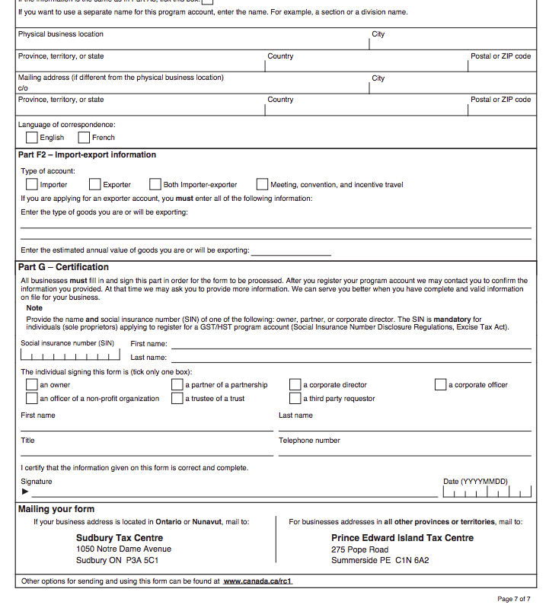
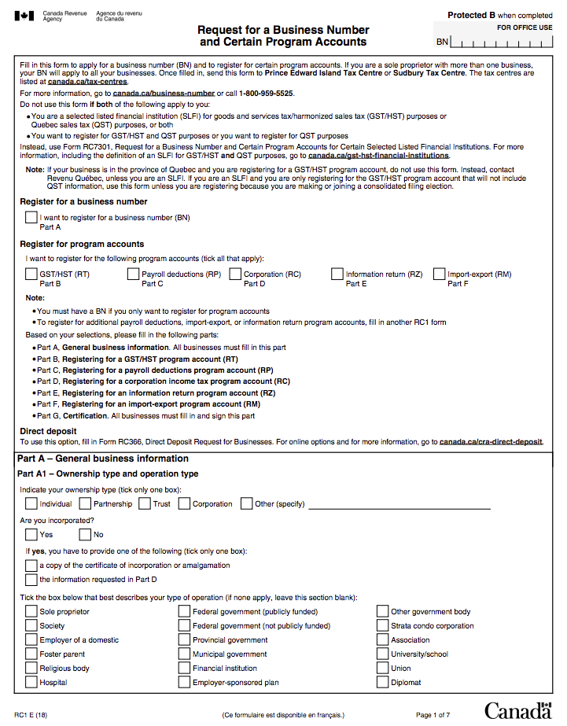
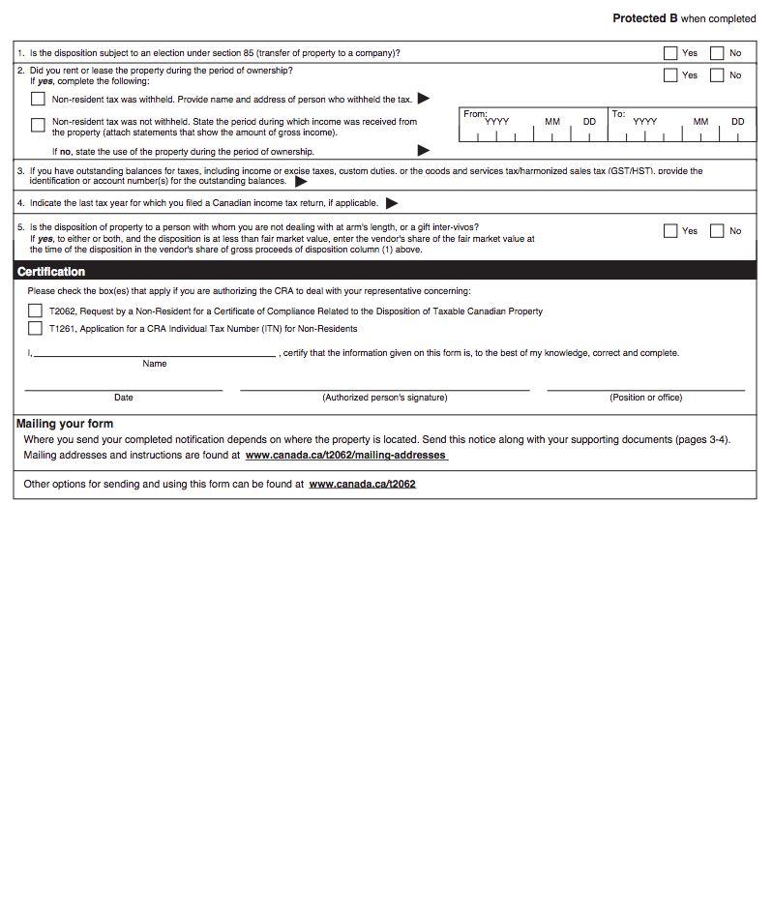
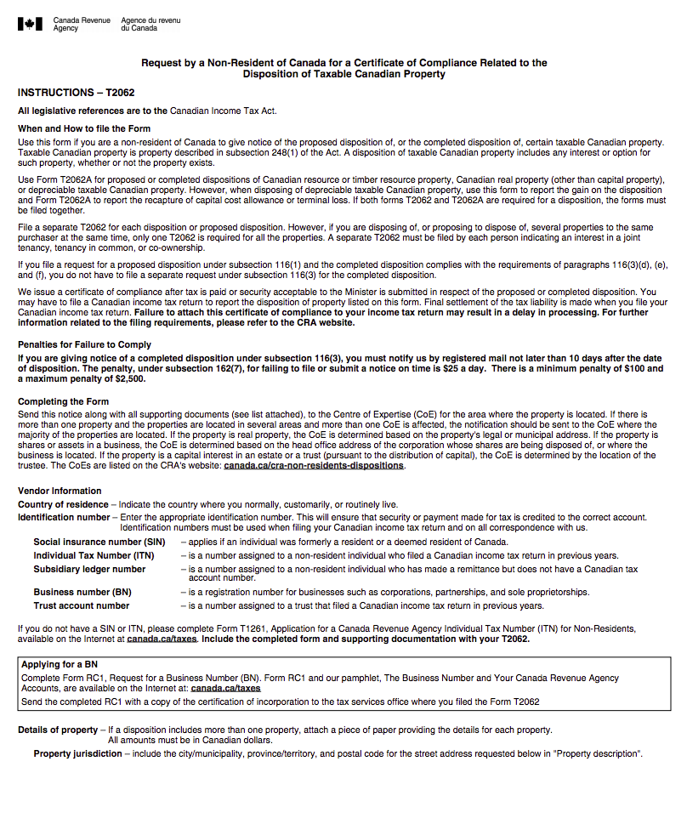
Add address at bottom of form worked well - everyone looked there
Baseline
Current RC1: 0% success
Validation
Current T2062: 22% success
T2062: New section with link had 89% success
16/20 looked for address at bottom of form
RC1: Add both addresses & align by province - 100% success
Notes:
RC1 https://gc-proto.github.io/cra-contactus/scenarioA/revenue-agency/services/forms-publications/forms/rc1-18e-op.pdf
T2062 https://gc-proto.github.io/cra-contactus/scenarioA/revenue-agency/services/forms-publications/forms/t2062-18e-op.pdf

Slide 7
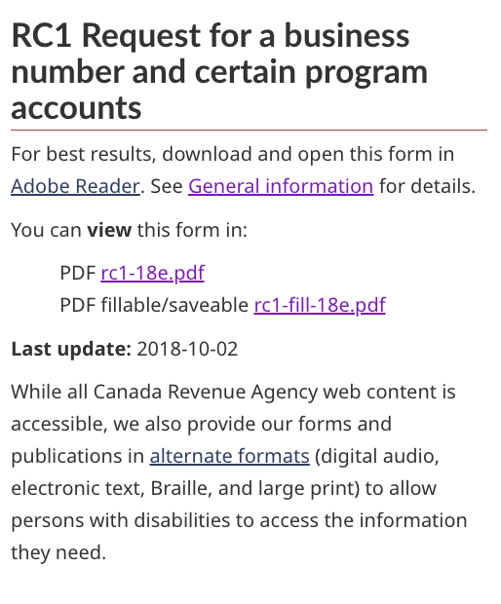
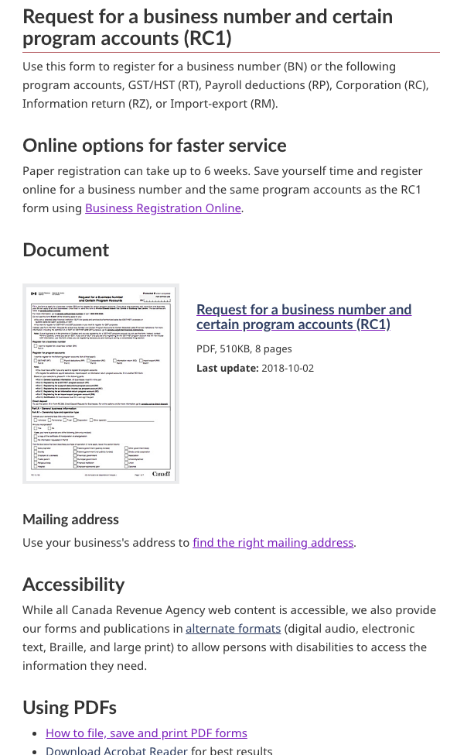
New form page template - hub for all relevant info including online options
Baseline
Description of form - place for additional links
Validation
Promote online options
Links are all about using PDFs/Adobe
Show and name the form - include mailing instructions

Slide 8
Iterating - making design changes based on behaviour and issues during validation sessions

Slide 9
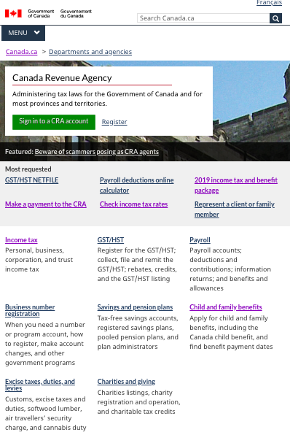
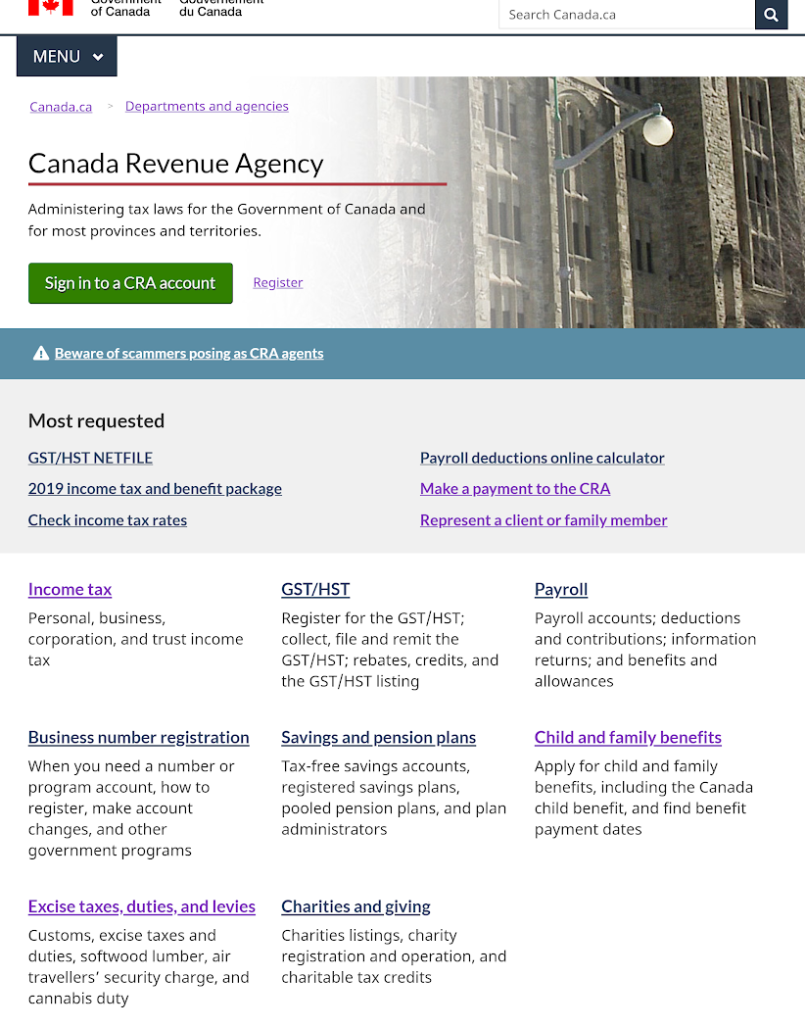
Iteration 1
Institutional Profile iteration
Iteration 2
Many were confused between the IP and Canada.ca homepage
P10T8: “,
3 out of 6 used the feature after update
0 out of 12 used it before the update

Slide 10
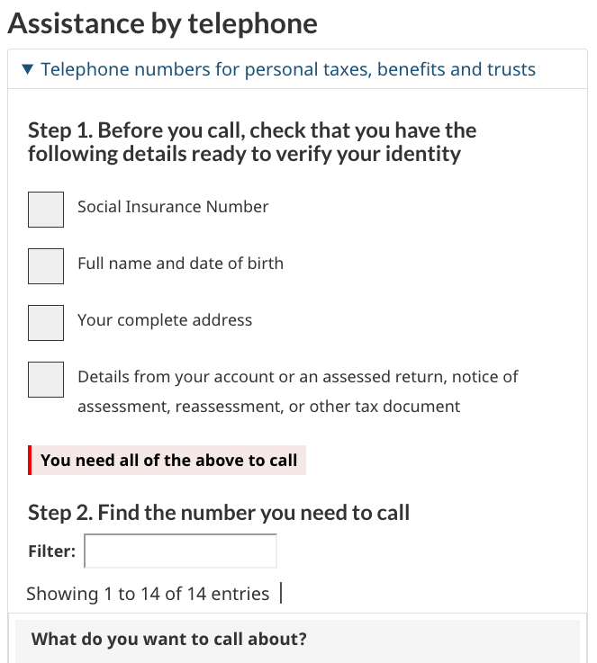
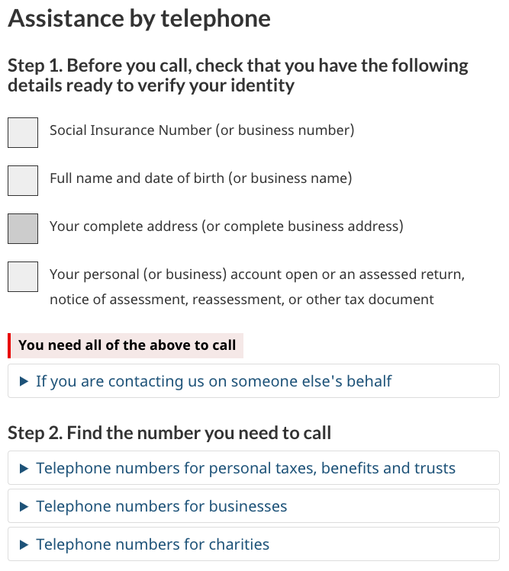
Before you call should remain out of the expand collapse
Iteration 1
Iteration 2
Some missed the Before you call section when it was inside the telephone number box and missed table filtering
People noticed ‘Find the number heading helped understand the expand collapses

Slide 11
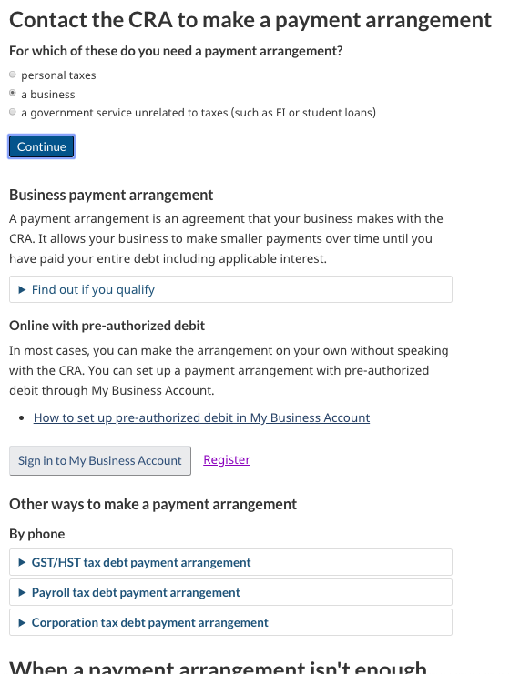
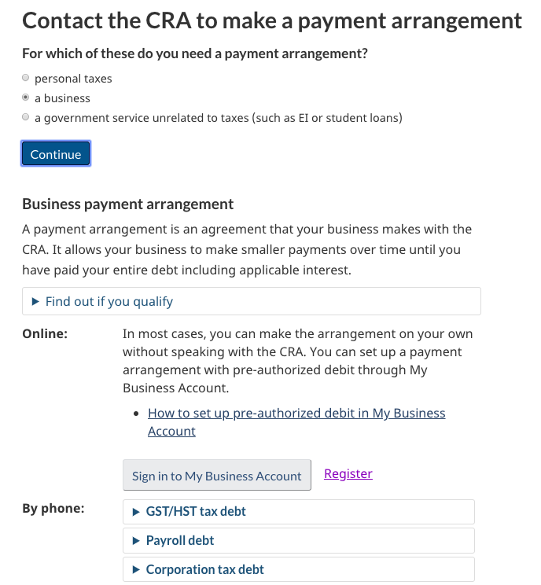
Contact channels on the left, instead of inline
Iteration 1
Iteration 2
People associated the channels with “By phone” when they were shown on the left side
People didn’t see the ‘By phone’ heading - read the channels text only

Slide 12
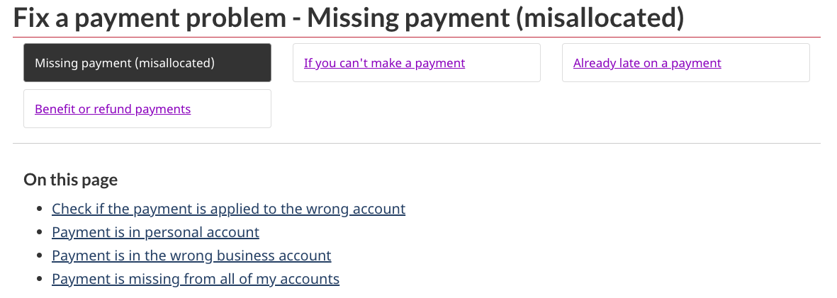
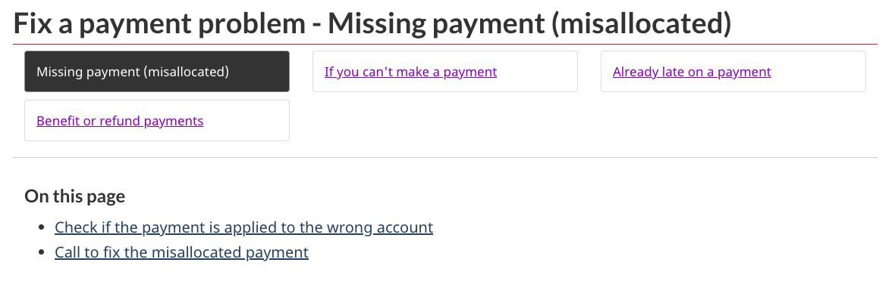
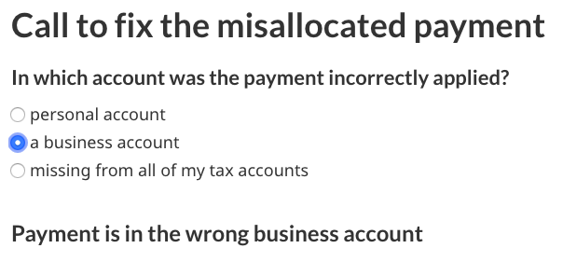
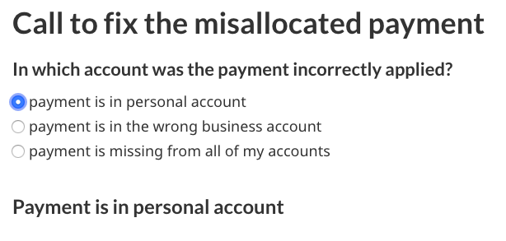
‘On this page’ not for mutually exclusive decisions
Iteration 1
Iteration 2
Keep On this page simple
Went to first bullet, and were likely to call the first number
Iteration 2
Iteration 3
Make it clear the option is the account the payment was applied to
In iteration 2, business was chosen - Canadians won’t read the question or heading

Slide 13
Next steps
Resolve some of the outstanding prototype issues - see updated version
https://gc-proto.github.io/cra-contactus/ut-en-prototype.html
Wizard was made in DialogFlow, needs to move out for implementation
- check that ALL phone numbers are findable from wizard, update language to make clear choices
Fill out Address finder spreadsheet for ALL forms - only about half done
Instructions are on Github with the files, talk to Nneka in PAB
Alignment issue must be resolved before TSO/TC pages are removed
CRA implementation plan for information architecture of new contact pages
Skip Canada Child Benefit for now - next project...

